Slide 1
Introduction to DNA Computing
Introducer: 黃宏偉
Adviser: 楊昌彪 教授

Slide 2
Definition
A new computation paradigm
Employ molecule manipulation to solve computational problems
Data could be encoded in DNA strands, and molecular biology techniques could be used to execute computational operations

Slide 3
Advantage
DNA computing has the potential to provide huge memories
Computing with DNA also has the potential to supply massive computational power

Slide 4
DNA Algorithm Concepts
A DNA algorithm is applied a test tube
consisting of DNA molecules which encode
the input data
A large set of data is assembled from
the input data
Those data are eliminated which do not
correspond to solutions
Gat some feasible answer

Slide 5
A Famous Example
Molecular Computation of Solutions to Combinatorial Problems
Author: Leonard M. Adleman
Science, Vol.266, pp.1021-1024, Nov. 1994

Slide 6
A Famous Example(cont.)
Hamiltonian Path Problem
4
3
1
0
6
2
5
Solution: 0 → 1 → 2 → 3 → 4 → 5 → 6

Slide 7
A Famous Example(cont.)
HPP is a NP-Complete problem
No efficient (that is, polynomial time) algorithm exists for solving the problem

Slide 8
Algorithm for HPP
Generating random paths through the graph.
Keep only those paths that begin with v_{in} and end with v_{out}.
If the graph has n vertices, then keep only those paths that enter exactly n vertices.
Keep only those paths that enter all of the vertices of the graph at least once.
If any paths remain, say “Yes”; otherwise say “No”.

Slide 9
Implementing Step 1
Each vertex encoded by random 20bp sequences
Vertex 2
Vertex 3
TATCGGATCG GTATATCCGA
GCTATTCGAG CTTAAAGCTA
GTATATCCGA GCTATTCGAG
Edge 2->3

Slide 10
Implementing Step 2 & 3
Step 2: PCR by vertex 0 (starting point) and vertex 6 (ending point)
Step 3: Run on an agarose gel and Find the 140-base bp band
PCR products encoding the desired path would have to be 7*20=140bp

Slide 11
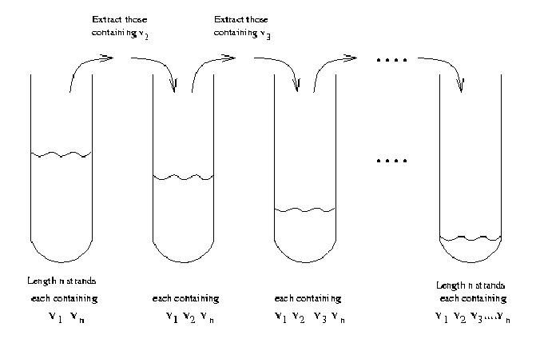
Implementing Step 4
affinity-purification

Slide 12
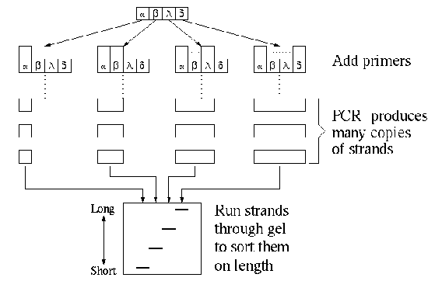
Implementing Step 5
Find solutions by “graduated PCR”

Slide 13
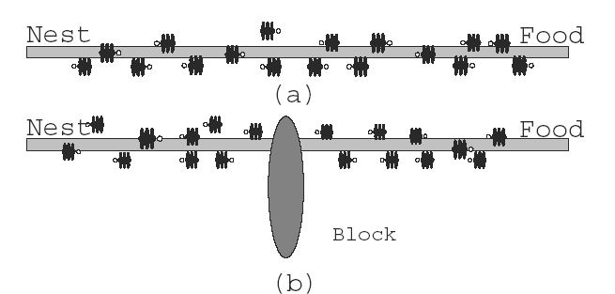
Ant Colony Optimization Algorithm(ACO)

Slide 14
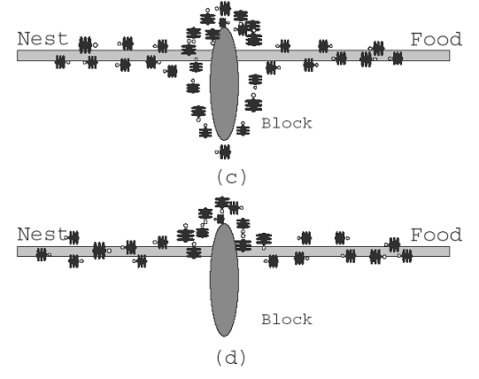
Ant Colony Optimization Algorithm(ACO)

Slide 15
Ant Colony Optimization Algorithm(ACO)
Set parameters and initialize pheromone trails
Each of ants constructs a solution
Calculate the scores of all solutions
Update the pheromone trails
If the best solution has not been changed after some predefined iterations, terminate the algorithm; otherwise, go to step.2

Slide 16
Use ACO to Solve TSP
Problem: find a minimum length path in the input cities which every city is visited exactly once

Slide 17
Our Method
V_{i}
V_{j}
E_{i->j}

Slide 18
Our Method
利用weight做為數量的控制， weight越小，量越多
代表edge的DNA strand，中間設計了restriction sites
把含有代表各種edge的strands置於tube 1，將含有代表各個vertex的strand之complementation置於tube 2
將兩個試管混合，則會有下列方法去造出initial data pool

Slide 19
Our Method
E_{i->j}
E_{j->k}
C(V_{j})
問題：
會產生經過重複vertex
跟不會經過所有vertex的問題

Slide 20
Our Method
解決重複問題的方法
E₁₋₂
E₂₋₃
E₃₋₄
E₄₋₂
E₂₋₅
2`
2`

Slide 21
Our Method
extend
2`
2`
剩下來完整的DNA strands
不會有重複的segment

Slide 22
Our Method
將經由上述兩個operation後剩下的DNA strands 加入另一個tube，其中的strand
形式如下：
E_{a-b}
E_{b-c}
E_{c-d}
E_{m-n}
在另一個tube中 準備含有每一種edge的complementation 的DNA segments C(E_{i-j})
把兩個 tube的內容物混合

Slide 23
Our Method
此時在tube中的混合物，會作hybrid 跟anneal 如下圖：
E_{a-b}
E_{b-c}
E_{c-d}
E_{m-n}
C(E_{a-b})
C(E_{b-c})
C(E_{c-d})
C(E_{d-e})

Slide 24
Our Method
E_{a-b}
E_{b-c}
E_{c-d}
E_{m-n}
C(E_{a-b})
C(E_{b-c})
C(E_{c-d})
C(E_{d-e})
Restriction enzyme 會將double strand DNA給切開 再利用切開的片段去進行複製

Slide 25
Our Method
在DNA data pool中，每一個single strand DNA 都代表一個可能的solution 若是越多的solutions經過一個特定的edge 則代表該edge的DNA segment 在這些single strand DNA 出現的頻率越高
E_{b-c}
E_{c-d}
C(E_{b-c})
C(E_{c-d})
利用以上這種已經切開的片段 去進行複製 可以讓出現頻率較高的segment複製較多份 相對的 出現次數較低的 複製量較少 最後的結果 則成為下一次 iteration的input

Slide 26
Our Method
問題
  如何解決未經過所有vertex的問題？
  如何將total path 長度較佳的solution挑出來？
  如何對desired edges做大量複製？

Slide 27
Thank you

